Slide 1
NBAC TSC Slides 24 April 2025 Meeting
Stephen Sullivan

Slide 2
24 APRIL 2025 NBAC TSC Agenda
1:00 NBAC Chair (s) Opening Remarks – Mr. Kamran Atri, Thomas Krul & Paul Wormeli
1:10 NIEM Management Office (NMO) Update – Mr. Steve Sullivan
April NBAC/NTAC Meeting Highlights
22 May Webinar
29 May PGB Meeting
8 October Reveal
Technical Announcements
1:20 Forensics Prospective Domain Presentation - Ryan Triplett & Kamran Atri
1:45 NTAC Update – Scott Renner, Brad Bolliger
1:50 Communications & Outreach NMO Sub-Committee update – Paul Wormeli
1:55 Community Updates – all
2:00 Questions/Final Remarks

Slide 3
NIEM Management office
Conducted April 16-17 NBAC/NTAC Meeting @ IJIS, Ashburn, VA
https://github.com/niemopen/nbac-admin/tree/main/16-17-april-2025-nbac-ntac-meeting-docs
Big Picture
Reduce DOD Footprint
Transition responsibilities among sponsoring organizations & committees
Share DOD technical resources/support
Share DOD management support/roles and responsibilities (NMO)
Broadly realign NIEMOpen governance, roles and responsibilities at committee level
Stand up workgroup to consider alternatives and present to PGB
Increase Revenue Available to NIEMOpen:
Diversify funding sources.
Reduce historical reliance on DOD and other Federal partner largesse.
Emphasized the need for broad NIEMOpen participation in cultivating sponsors, focus on maintaining current sponsors and identifying and onboarding new sponsors.
13 near tear sponsor prospects identified, capture managers assigned, ~ 330K near term budget plus-up.
Pursue monetizing NIEMOpen services – training & tech support.
Investigate feasibility of establishing a requirement for new domain organizations to become sponsors and pay instantiation fee.
Pursue Congressional line item in budget in consonance with new Administration focus on Federal interoperability.

Slide 4
NIEM Management office (cont)
Big Picture (CONT)
Identify Ways to Distribute and Resource Lead Developer Tasks
Historically NIEM relied on Lead Developer contract support for technical architecture and model tasks (2-2 1/2 Senior FTEs)
Identified historical/current Lead Developer tasks:
Model maintainer
Harmonization process lead
Domain content QA
Configuration management
Model change management documentation
Specification and model release process.
Revisit Technical Steering Committee Roles and Responsibilities to realign support for Lead Developer activities
Assemble Working Group to explore alternatives and report to PGB at 27 May PGB Meeting.
Identify tasks that can be absorbed by NTAC & NBAC
Identify support-in-kind from sponsoring and member organization/participants
Pursue 100K bridge funding from NIEMOpen PGB.
Create business case for 27 May PGB Meeting
Pre-stage SOW expecting favorable PGB vote.

Slide 5
NIEM Management office (cont)
Big Picture (CONT)
Establish Priorities
Decrease DOD Footprint.
Approve NDA PSD01 & Model Version 6.0 PS02
Finish tooling.
CMF Tool
API 2.0 + model management tasks as feasible
MEP tool compatibility with API 2.0 and Model Version 6.0.
Identify and secure near-term sponsorship and funding for tech support.
Capture PGB support for 100K tech bridge funds.
Develop COAs for NBAC, NTAC, NMO to reduce DOD footprint and ameliorate Lead developer tasks.
Articulate new Vision highlighting new NDR, model version and tooling as marketing tool.
Develop view of future NIEM architecture incorporating knowledge graph and AI technologies.
Explore methodologies of comporting other standards with NIEM.

Slide 6
NIEM Management office (cont.)
April 28 – 1May California County Information Services Directors Association (CCISDA) Spring Conference, Eveline Resort & Spa, Lake Tahoe, CA
Paul Wormeli Guest Speaker
https://ccisda.org/page/2025SC
Webinar 22 May 1-3 PM EDT
Registration: https://ijis.org/events/niemopen-webinar-unveiling-the-future-of-niem/#!event-register/2025/5/22/niemopen-webinar-8211-unveiling-the-future-of-niem
Next PGB Meeting 29 May 2-4 PM EDT
Microsoft Teams May PGB
Join the meeting now
Meeting ID: 993 272 665 665
Passcode: yQ6Cz6Wh
Dial in by phone
+1 410-874-6749,,743104072# United States, Odenton
Phone conference ID: 743 104 072#
NIEM Reveal 8 October 2025, Planning Started, National Press Club, Washington, DC

Slide 7
Technical Announcements
NIEMOpen NDR v6.0 PSD01 Approved
Submitted for Publication to OASIS Library
The permanent "Latest stage" URI will be: https://docs.oasis-open.org/niemopen/ndr/v6.0/ndr-v6.0.html
Current Version: https://github.com/niemopen/niem-naming-design-rules
NIEM Model v6.0 PS02 Approved
The permanent "Latest stage" URI will be: https://docs.oasis-open.org/niemopen/niem-model/v6.0/niem-model-v6.0.html
Dev version: https://github.com/niemopen/niem-model/tree/dev

Slide 8
Webinar
Event date: Wednesday 22 May, 1:00 p.m.
Duration: 2 hours—90 minutes for presentations,
30 minutes for Q&A
Press Releases:
NIEMOpen.org News, https://niemopen.org/news/free-webinar-unveiling-niem-version-6-0/
NBAC, NTAC, PGB announcement, https://lists.oasis-open-projects.org/g/niemopen-nbactsc/topic/niemopen_webinar_22_may_2025/111747876
IJIS Registration Site: https://ijis.org/events/niemopen-webinar-unveiling-the-future-of-niem/#!event-register/2025/5/22/niemopen-webinar-8211-unveiling-the-future-of-niem
EINPRESSWIRE https://www.wjhl.com/business/press-releases/ein-presswire/793904715/free-webinar-unveiling-niemopen-6-0-release/
Agenda:
1:00 Welcome and relevance - Maria Cardiellos (Executive Director, IJIS)
1:10 Introduction to the new NIEMOpen – Katherine Escobar (PGB Chair)
1:20 The New NIEM
New NIEM Model Version 6.0 – Dr. Scott Renner (NTAC Co-Chair)
CMF/CMF Tool ( includes demo) – Dr. Scott Renner (NTAC Co-Chair)
API 2.0 – Dr. Scott Renner (NTAC Co-Chair)
NDR 6.0 and toolkit + future updates – Dr. Scott Renner (NTAC Co-Chair)
1:50 Future Architecture, role of Ontologies, and AI - Brad Bolliger (NTAC Co-Chair)
2:00 The future of NIEMOpen with OASIS – Jim Cabral ( Director OASIS)
2:10 NIEM on the ground – Maria Cardiellos (Executive Director, IJIS) TBD
2:20 New dimensions for NIEMOpen in ontologies – Carolyn Staats (Sonoma County)
2:30 The future, plans and resources – Katherine Escobar
2:35 Q&A (panel with Katherine Escobar, Maria Cardiellos, NBAC and NTAC Co-chairs)
3:-00 Close

Slide 9
Backup

Slide 10








Resources
Follow Us On Twitter
https://twitter.com/NIEMconnects?ref_src=twsrc%5Etfw
Katherine Escobar, katherine.b.escobar.civ@mail.mil, 757-203-8631
Git Repos
NIEMOpen: https://github.com/niemopen/
NTAC TSC
https://github.com/niemopen/ntac-admin
NBAC TSC
https://github.com/niemopen/nbac-admin
NMO TSC
https://github.com/niemopen/nmo-admin
NIEMOpen Slack Channel: https://niemopen.slack.com/
Mailing Lists
NIEMOpen: https://lists.oasis-open-projects.org/g/niemopen
PGB: https://lists.oasis-open-projects.org/g/niemopen-pgb
NTAC TSC: https://lists.oasis-open-projects.org/g/niemopen-ntactsc
NBAC TSC: https://lists.oasis-open-projects.org/g/niemopen-nbactsc
NMO TSC: https://lists.oasis-open-projects.org/g/niemopen-nmotsc
https://www.niem.gov/
https://niemopen.org/
https://www.linkedin.com/groups/1903175/profile
https://www.youtube.com/channel/UCg9qV22PXLBjG41hc-EwVrQ
IEPD/MEP REPO
MEP TOOL
CMF TOOL
NDR v6.0 PSD01
NIEM Model v6.0 PS02

Slide 11
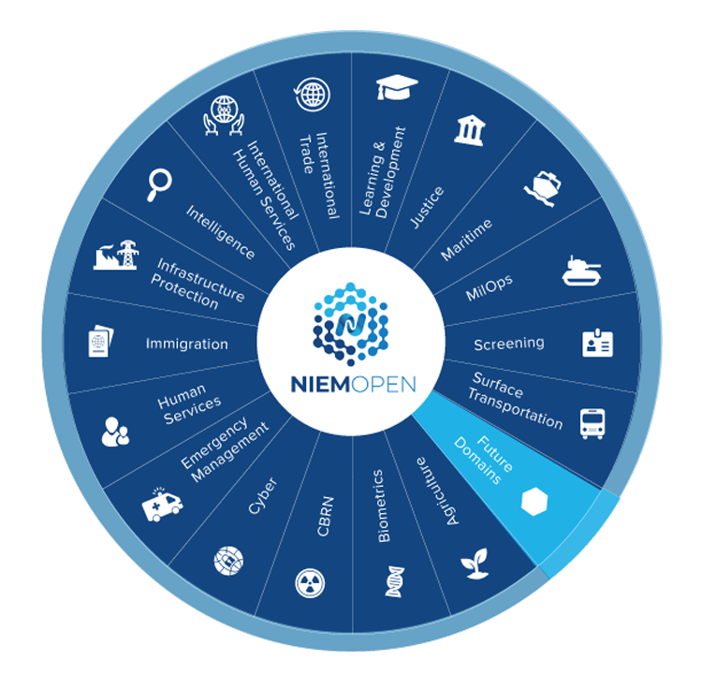
NIEMOpen Domains
17 Domains
4 in Conservatorship
Agriculture
Cyber
Infrastructure protection
Screening
3 Prospective Domains
IOC
May 2025
Aug – Sep 2025
Nov-Dec 2025
Forensics Domain
Analytical Laboratories Doman
Identity Management Domain

Slide 12




























NIEMOpen Current Sponsors
11 Sponsors, 3 Premier
Sponsors
JS J6
DHS S&T
CJIS (FBI)
GTRI
Equivant
NAJIS
BJS
IJIS
NIJ
APN
ODGA (Virginia)
Premier
Premier
Premier
All Purpose Networks, Inc.
Prospective Sponsors
DHS
OBIM
Office of Standards
Department of National Defense

Slide 13
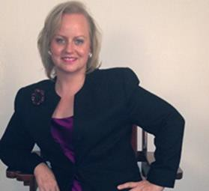
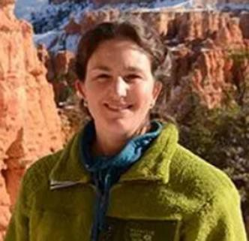

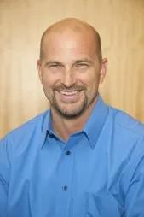
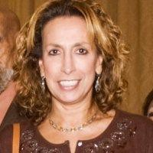
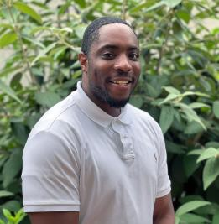
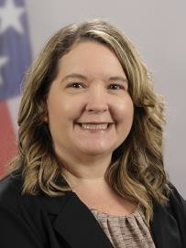
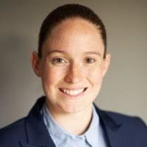
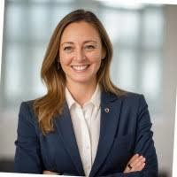
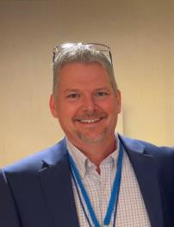
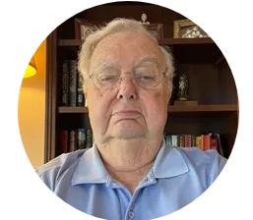
PGB APPOINTED VOTING MEMBERS
Ms. Katherine Escobar
PGB Chair Deputy Division Chief, Data and
Standards Division at Joint Staff J6 and NIEM Managing Director
Ms. Christina Bapst-Stump
Science and Technology Directorate,
US Department of Homeland Security
Mr. Gary Egner Director Business Development, Equivant
Mr. John Wandelt Principal Research Scientist, Georgia Tech Research Institute
Ms. Maria
Cardiellos Executive Director Integrated Justice Information Systems Institute
Mr. Payton Lamb Data Engineer Commonwealth of Virginia Office of the secretary of Administration
Office of Data Governance and Analytics
Ms. April Mitchell FBI It Specialist and Technical Lead of Data Standards in the Criminal Justice Information Services (CJIS) Division
Ms. Erin Partin Data Scientist, Office of the Principal Deputy Director, National Institute of Justice (NIJ)
Ms. Erica Smith Data Scientist, Unit Chief – Law Enforcement Incident-Based Statistics Unit, Bureau of Justice Statistics (BJS)
Mr. Tom Welch Director of Information Technology OHIO HIDTA –
Including Northern KY & Western PA
Mr. James T. Herbert
Company Advisor, All Purpose Networks, Inc. (APN)

Slide 14
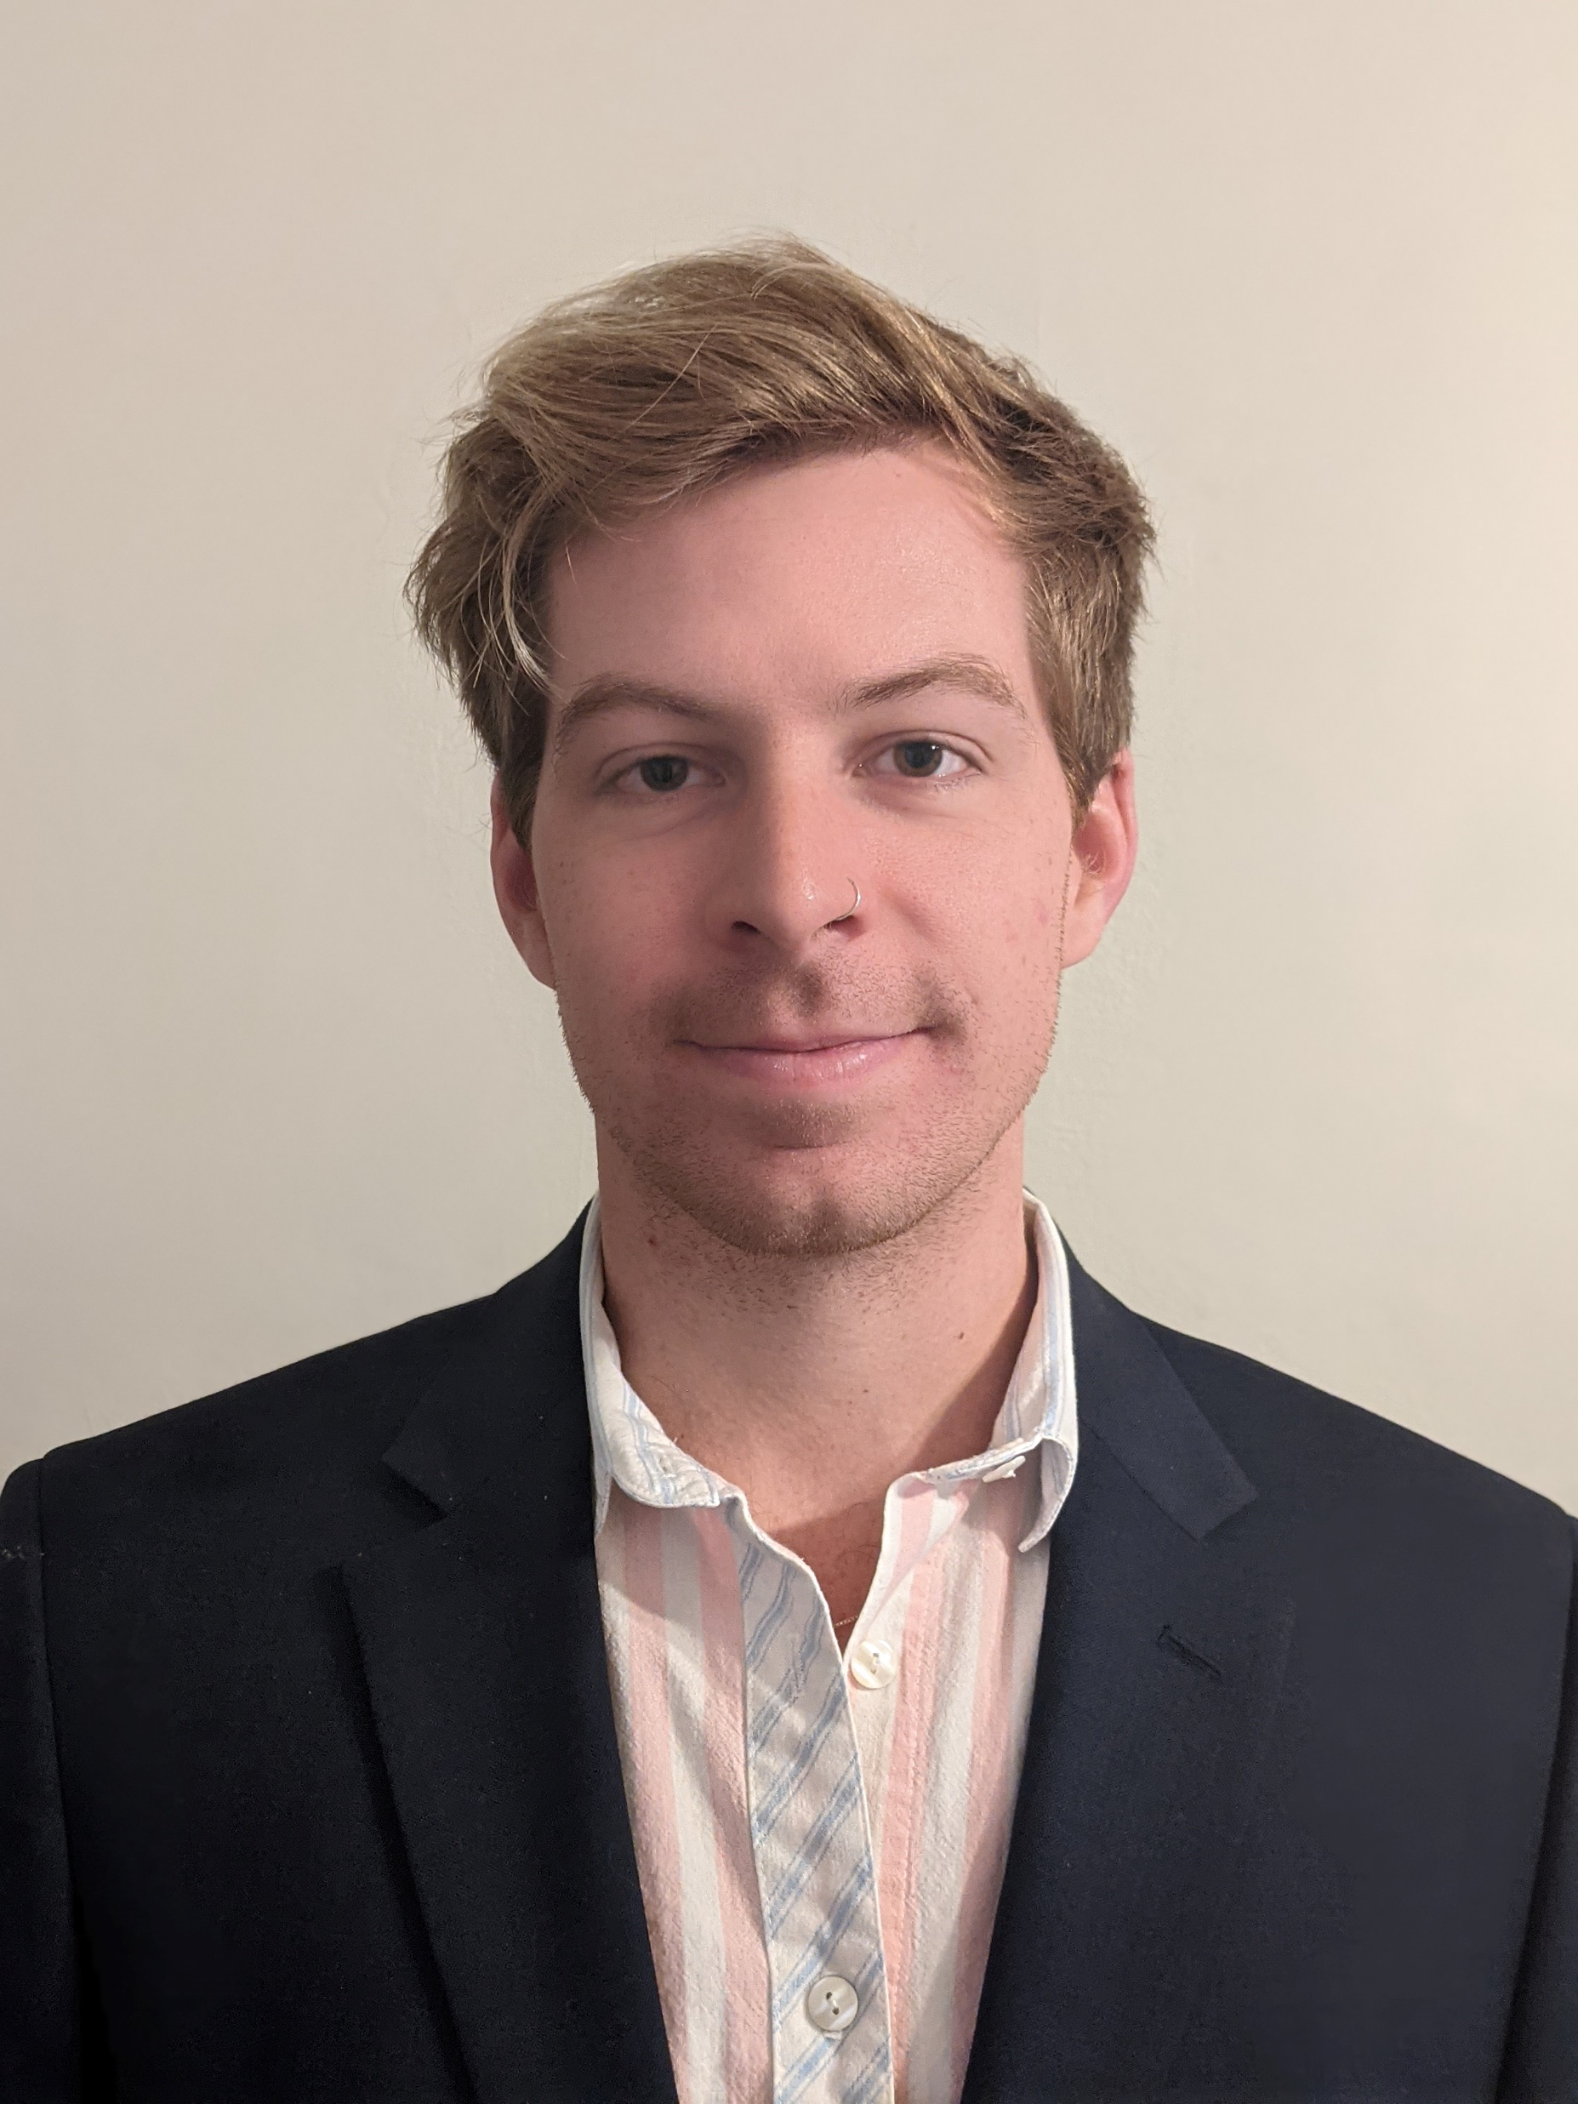
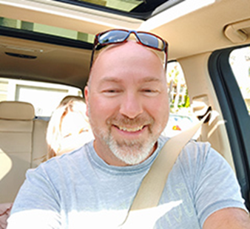
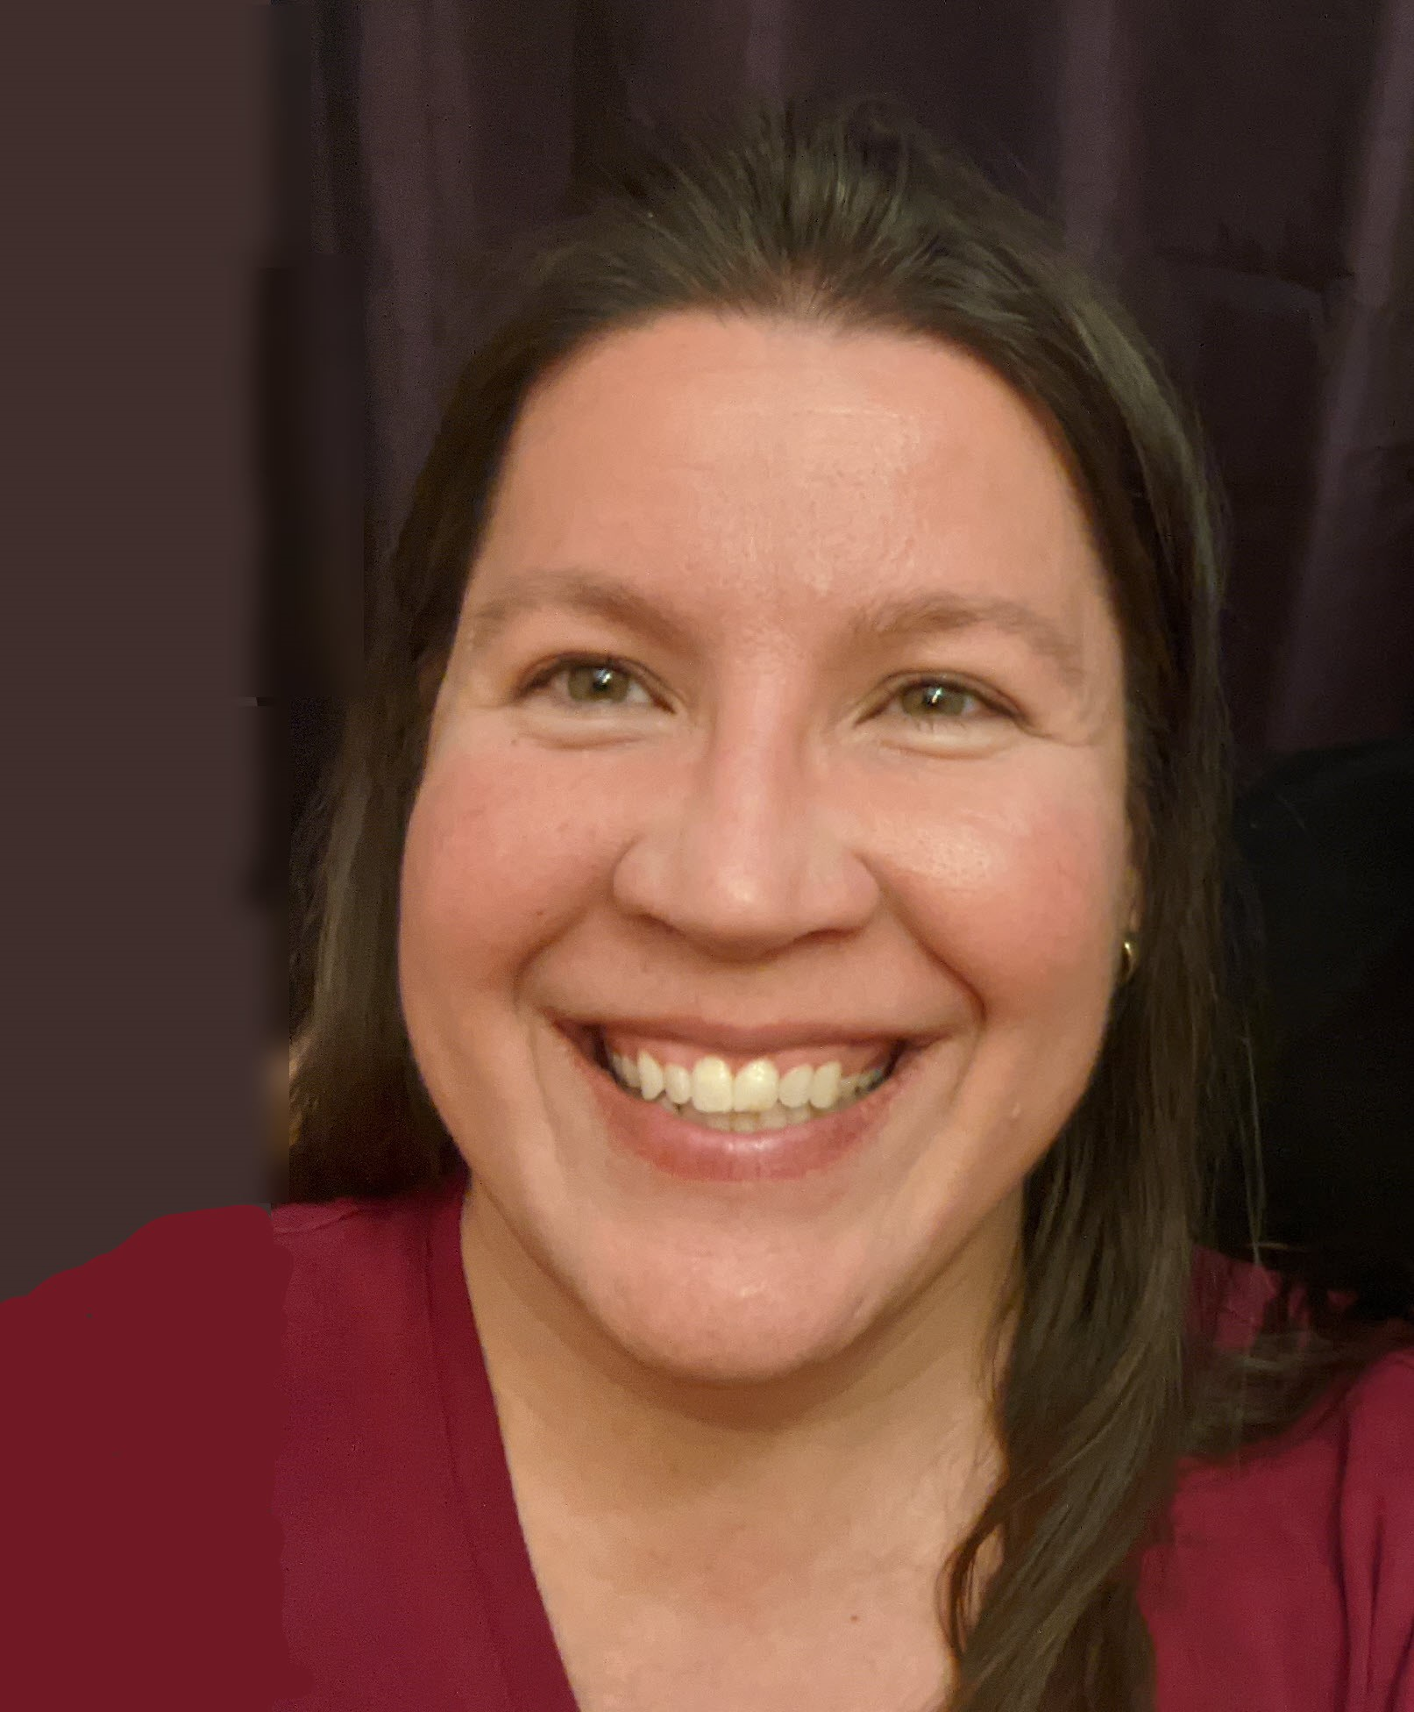

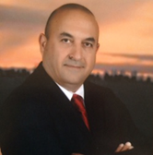
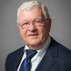
PGB EXPERT VOTING MEMBERS &
NON-VOTING MEMBERS
PGB EXPERT VOTING MEMBERS
Technical Steering Committees
PGB EXPERT NON-VOTING MEMBERS
Technical Steering Committees
Mr. Kamran Atri
Co-Chair, NIEM Business Architecture Committee TSC
Mr. Paul Wormeli
Co-Chair, NIEM Business Architecture Committee TSC
Mr. Brad Bolliger
Co-Chair, NIEM Technical Architecture Committee TSC
Mr. Thomas Krul
Co-Chair, NIEM Business Architecture Committee TSC
Ms. Darcy Staley
Co-Chair, NIEM Management Organization TSC
Dr. Scott Renner
Co-Chair, NIEM Technical Architecture Committee TSC
Notes:
Open Project Rules - OASIS Open (oasis-open.org)
5.1 Overall guidance for the Project is provided by its Project Governing Board (or PGB). The PGB is composed of one voting member from each Project Sponsor who elects to appoint a PGB member, and (a) if the PGB has one or more Technical Steering Committees, one voting expert representative from each TSC, elected or appointed by that TSC, or (b) otherwise, the PGB may appoint at least one and no more than two voting expert representatives from its community of contributors. The PGB may create additional non-voting PGB member seats for expert representatives to be elected by the TSC or appointed by the PGB. The PGB membership of all such members of any type is conditioned on satisfaction of the CLA requirement of Section 5.2. Voting status on the PGB may be affected by the provisions of Section 5.7.

Slide 15
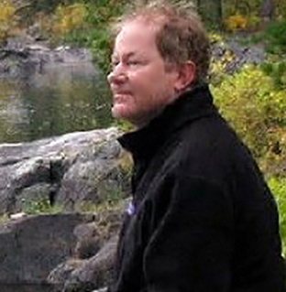

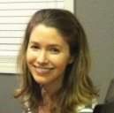
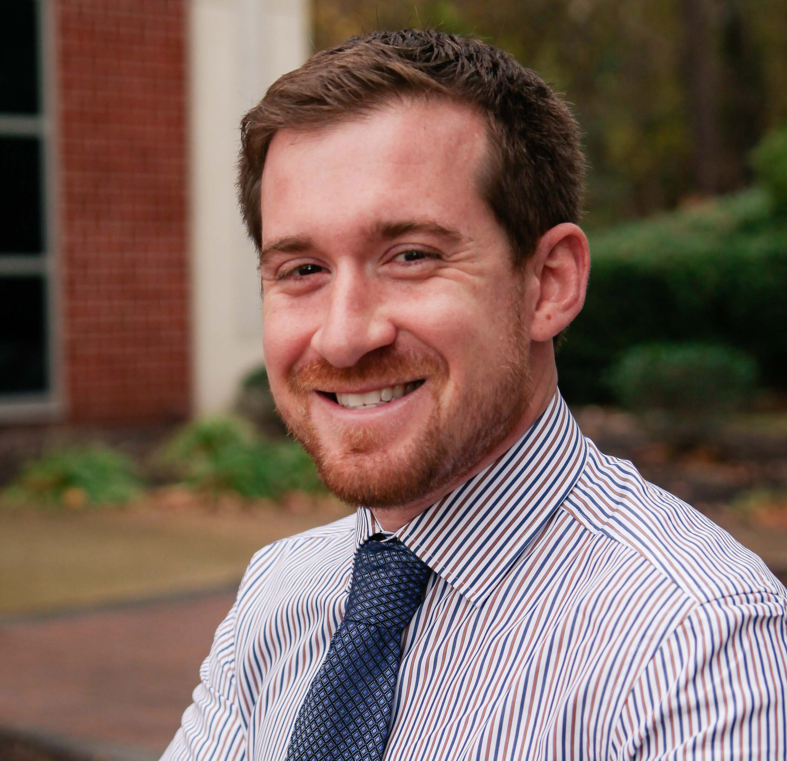

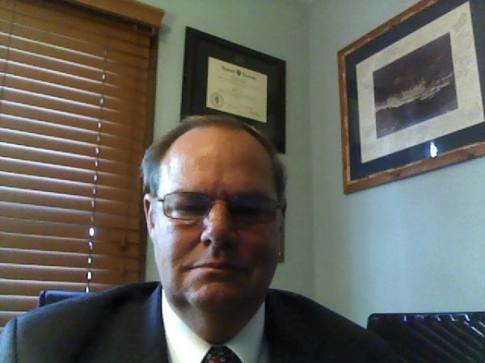
NMO, NBAC, & NTAC TSC Co-Chairs & OASIS Maintainers
TSC | Approved (TSC CHAIRS)
NMO TSC | Ms. Darcy Staley & Ms. Beth Smalley
NBAC TSC | Mr. Kamran Atri & Mr. Thomas Krul, Mr. Paul Wormeli
NTAC TSC | Dr. Scott Renner & Mr. Brad Bolliger
GitHub Repos | Primary | Alternates
NIEM Open | Ms. Christina Medlin, Mr. Aubrey Beach | Mr. Tom Carlson, Ms. Shunda Louis, Mr. Steve Sullivan (pgb-minutes)
NTAC-Admin | Dr. Scott Renner, Mr. Brad Bolliger | Mr. Aubrey Beach, Mr. Tom Carlson, Mr. Jim Cabral, Ms. Christina Medlin, Ms. Shunda Louis
NBAC-Admin | Mr. Steve Sullivan, Mr. Aubrey Beach | Ms. Shunda Louis, Ms. Christina Medlin
NMO-Admin | Ms. Darcy Staley, Mr. Aubrey Beach | Mr. Steve Sullivan, Ms. Shunda Louis
NTAC TSC
NBAC TSC
NMO
TSC
Christina Medlin
Aubrey Beach
Dr. Scott Renner
Brad Bolliger
Steve Sullivan
Darcy Staley

